Slide 1
Provenance research under the spotlight
Digital Edition of the Annual Reports of the Museum 1887-1915 and 1928-1938

Slide 2
Talk outline
Our approach in a nutshell
The annual Reports of the museum in the Chronicles
CIDOC CRM as Data model
Project status
Product
Visualized semantic graphs
Website

Slide 3
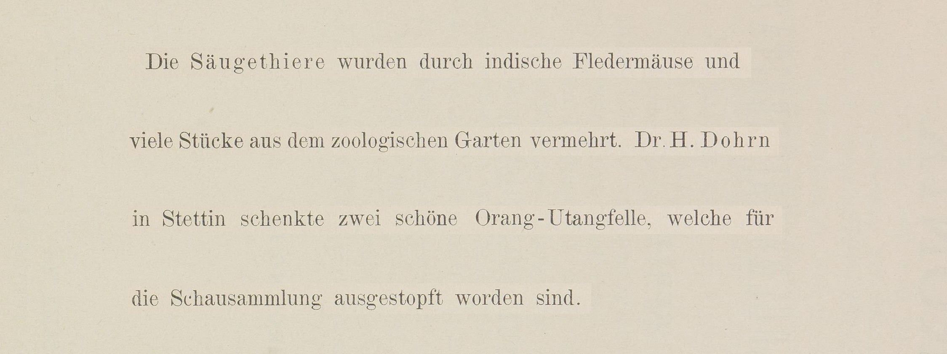
Modeling semantic Information I
Chronik der Friedrich-Wilhelms-Universität zu Berlin, Vol. 4 (1891), p. 125

Slide 4
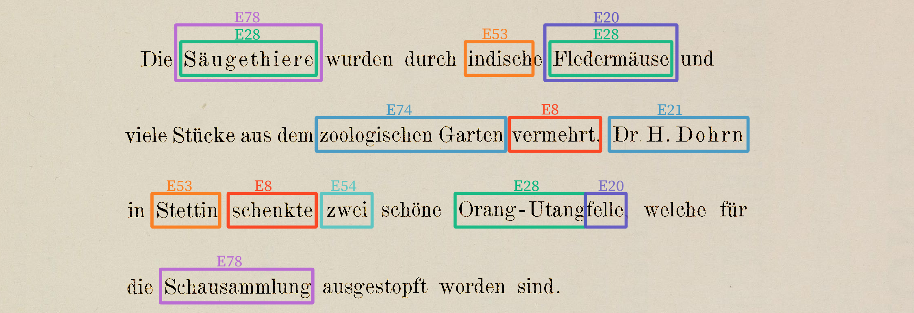
Modeling semantic Information II
Chronik der Friedrich-Wilhelms-Universität zu Berlin, Vol. 4 (1891), p. 125

Slide 5
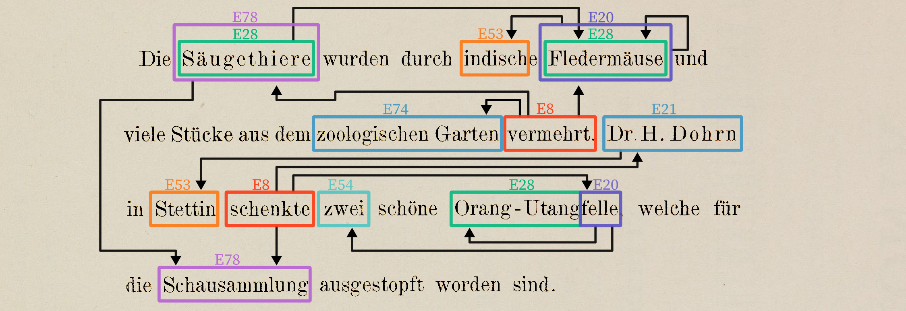
Modeling semantic Information III
Chronik der Friedrich-Wilhelms-Universität zu Berlin, Vol. 4 (1891), p. 125

Slide 6
Modeling semantic Information IV
E20 Biological Object
E53 Place
(1636)
P53
(1633)
Fledermäuse
indisch
E8 Acquisition
P24
E55 Type
E28 Conceptual Object
...
(1641)
P2
(1929)
P128
(1299)
...
vermehrt
P22
Donation
Fledermäuse
4 Neighbours
E78 Curated Holding
...
...
...
(1488)
...
7 Neighbours
...
28 Neighbours
Hauptsammlung
P46
...
E78 Curated Holding
E78 Curated Holding
...
(1490)
P46
(1649)
...
7 Neighbours
...
Säugethiere
Schausammlung
2 Neighbours
P2
P22
E21 Person
E53 Place
...
too many neighbours to draw
(1642)
P53
(1643)
P2
has type
Dr. H. Dohrn
Stettin
E8 Acquisition
P22
transferred title to
(1644)
P23
P23
transferred title from
schenkte
P24
P24
transferred title of
E14 Condition Assessment
P31
has modified
(1646)
E20 Biological Object
E28 Conceptual Object
P34
concerned
schöne
P34
(1648)
P130
(1647)
felle
OrangUtang
P43
has dimension
P31
P46
is composed of
E11 Modification
P43
E54 Dimension
(1650)
(1645)
P53
has former or current location
ausgestopft
zwei
P130
shows features of

Slide 7
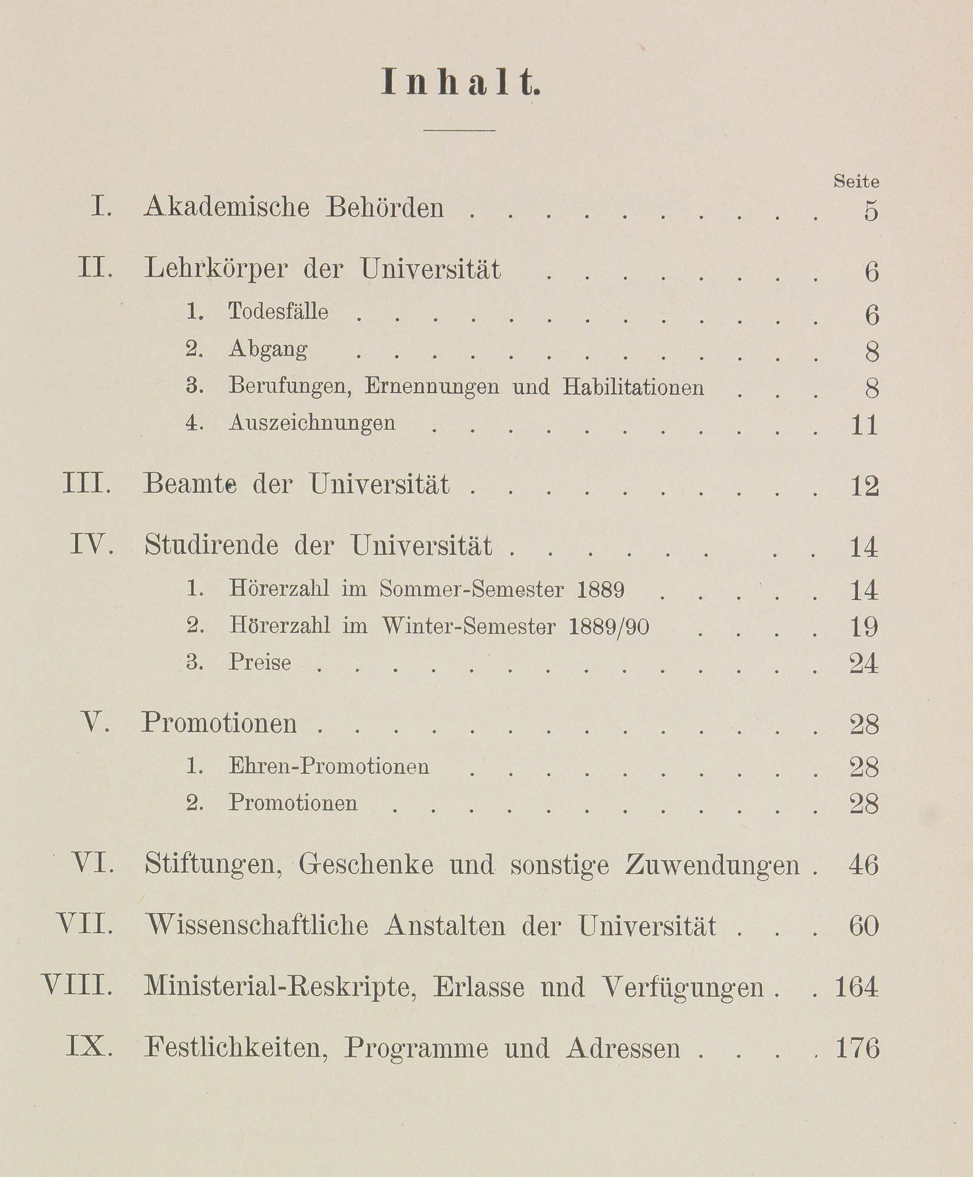
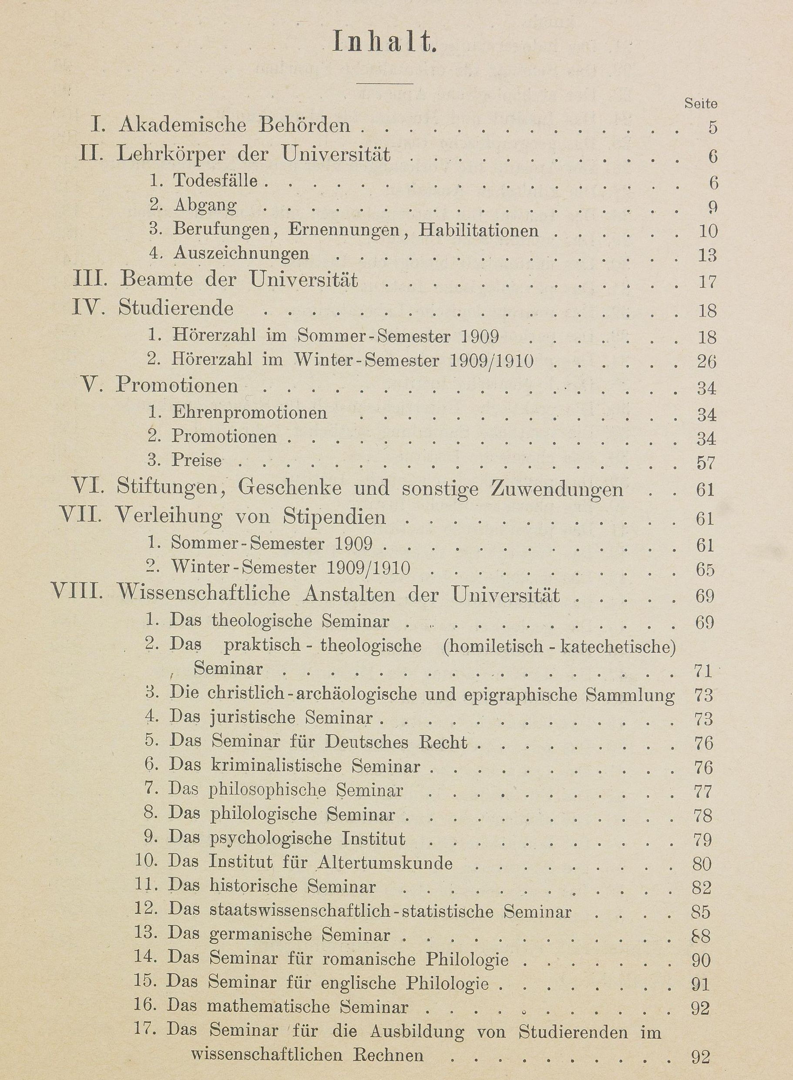
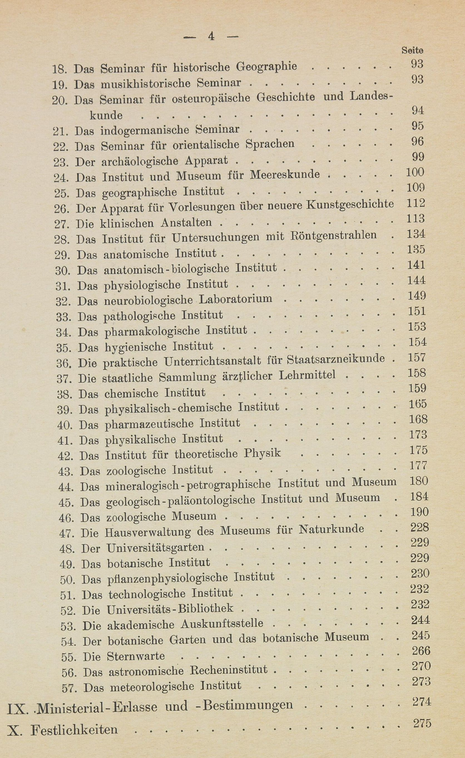
Annual Reports 1887–1915 and 1928–1938
1889/1890
1909
Digitized by HU Bibliothek: https://www.digi-hub.de/viewer/toc/BV046933380/1/-/

Slide 8
Naturkundemuseum in the Chronicles
964 Pages
60
Museum für Naturkunde – (Haus-)Verwaltung
Mineralogisch-petrographisches Institut/Museum/Sammlung
50
Geologisch-paläontologisches Institut/Museum/Sammlung
Zoologisches Institut/Museum/Sammlung
40
Number of Pages
30
20
10
0
1890
1900
1910
1920
1930
1940
Year
Digitized by HU Bibliothek: https://www.digi-hub.de/viewer/toc/BV046933380/1/-/

Slide 9
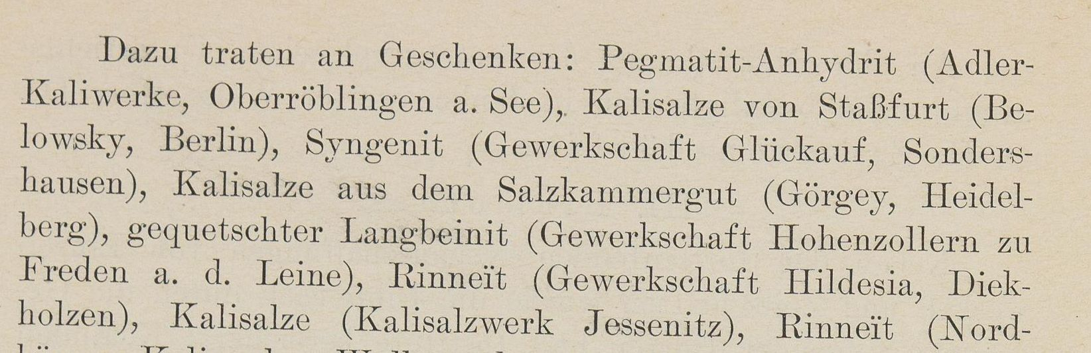
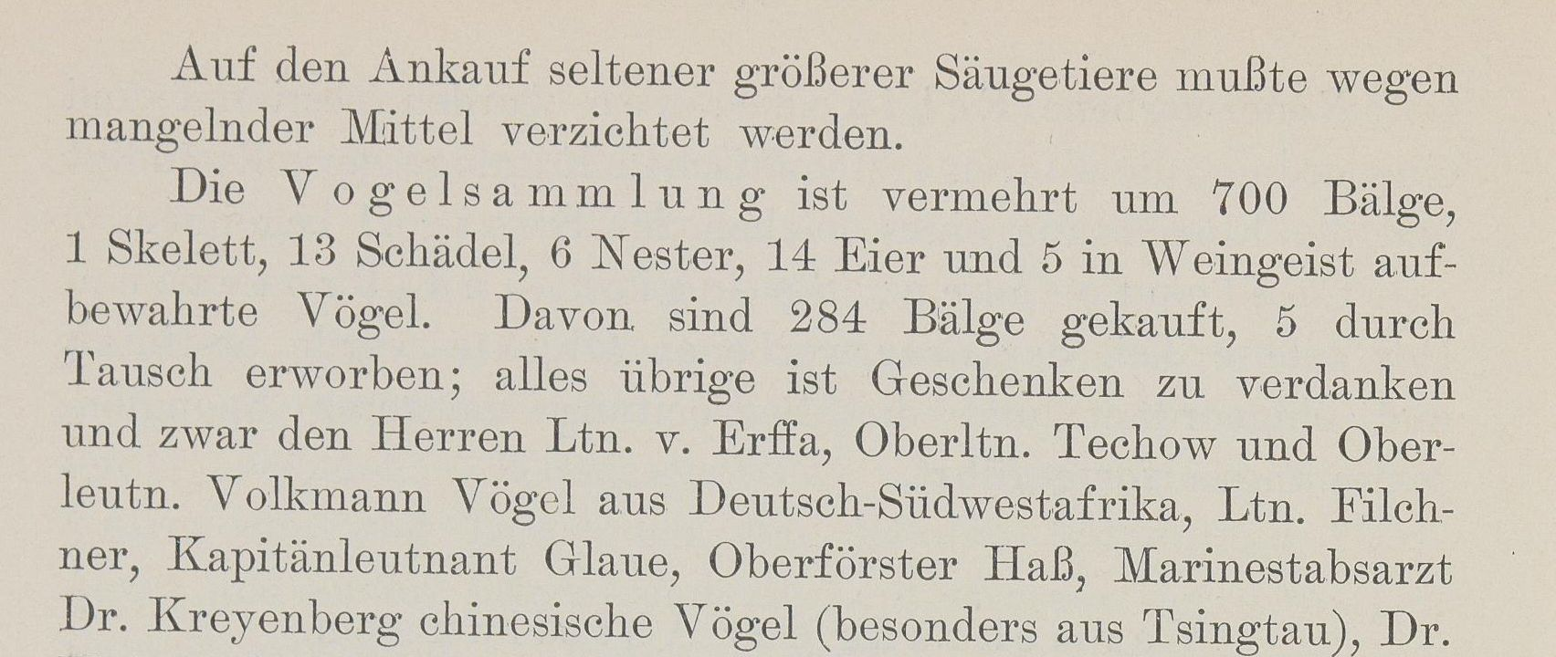
Inflow and outflow of objects in the collections
Chronik der Friedrich-Wilhelms-Universität zu Berlin, Vol. 23 (1909), S. 184
Topics addressed in the annual reports
Chronik der Friedrich-Wilhelms-Universität zu Berlin, Vol. 18 (1904), S. 186

Slide 10
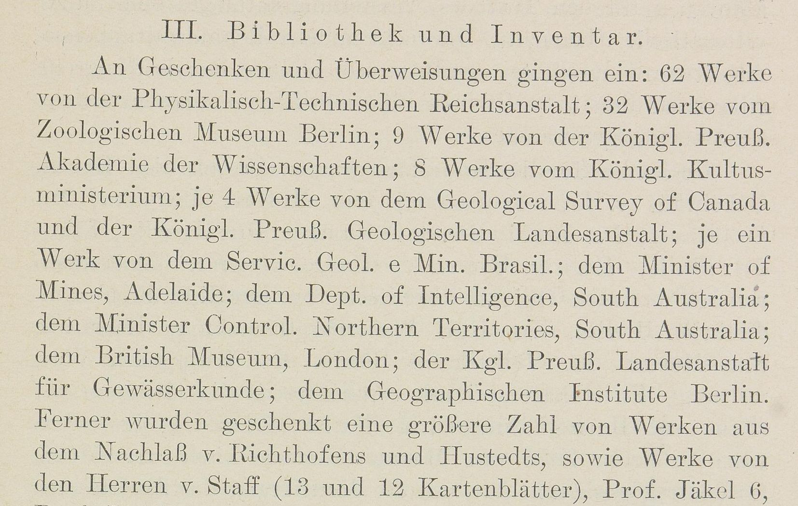
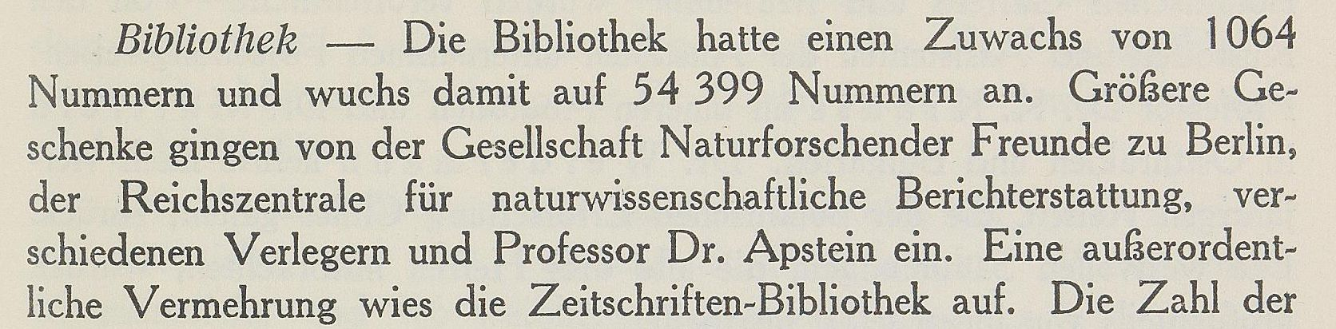
Acquisitions of publications in the library
Topics addressed in the annual reports
Chronik der Friedrich-Wilhelms-Universität zu Berlin, Vol. 23 (1909), S. 191
Chronik der Friedrich-Wilhelms-Universität zu Berlin, 1927/1928, S. 107

Slide 11
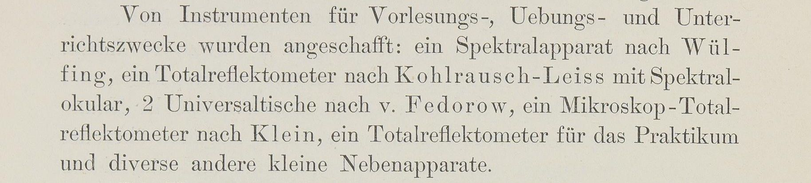
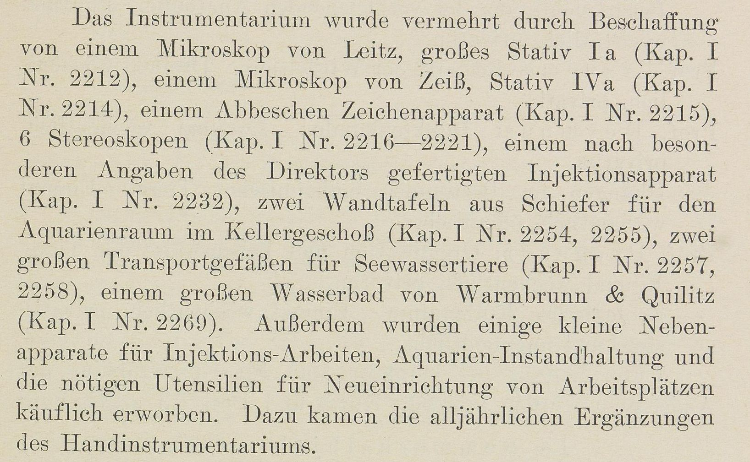
Acquisitions of instruments
Chronik der Friedrich-Wilhelms-Universität zu Berlin, Vol. 13 (1899), S. 146
Topics addressed in the annual reports
Chronik der Friedrich-Wilhelms-Universität zu Berlin, Vol. 23 (1909), S. 181

Slide 12
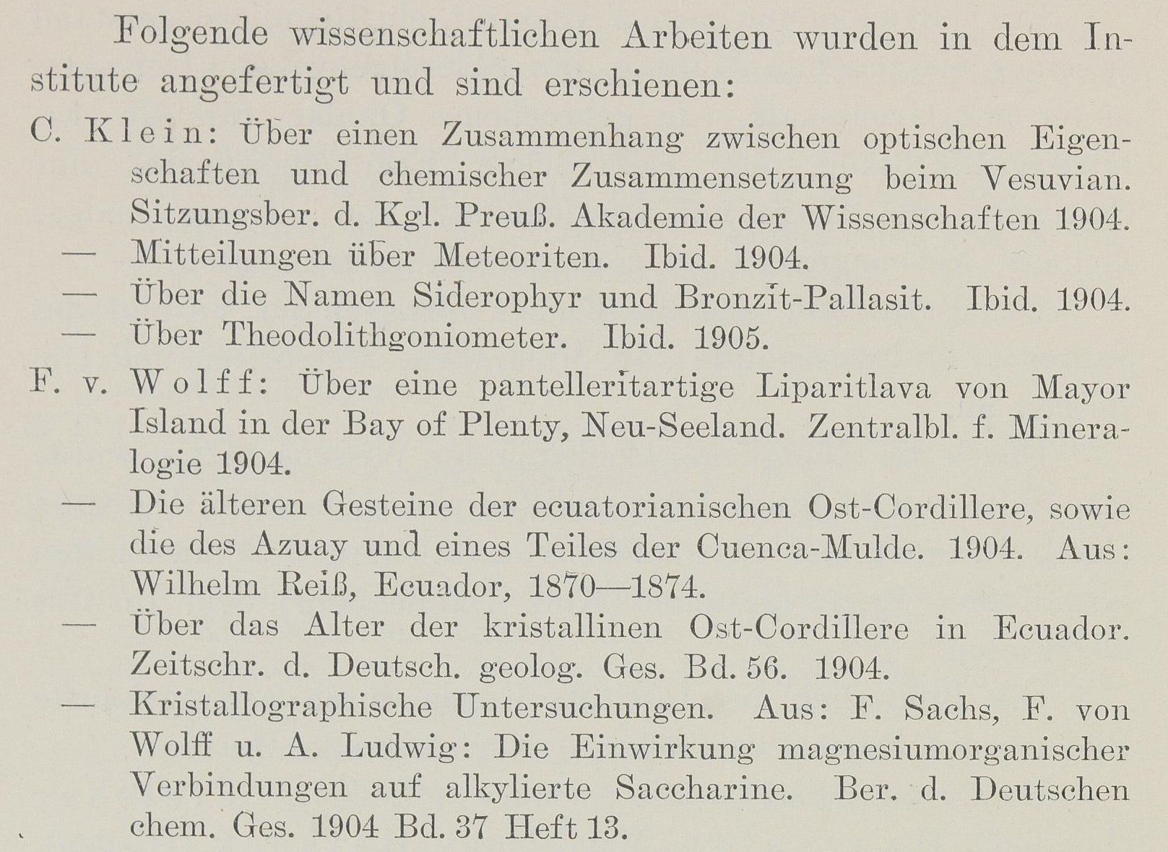
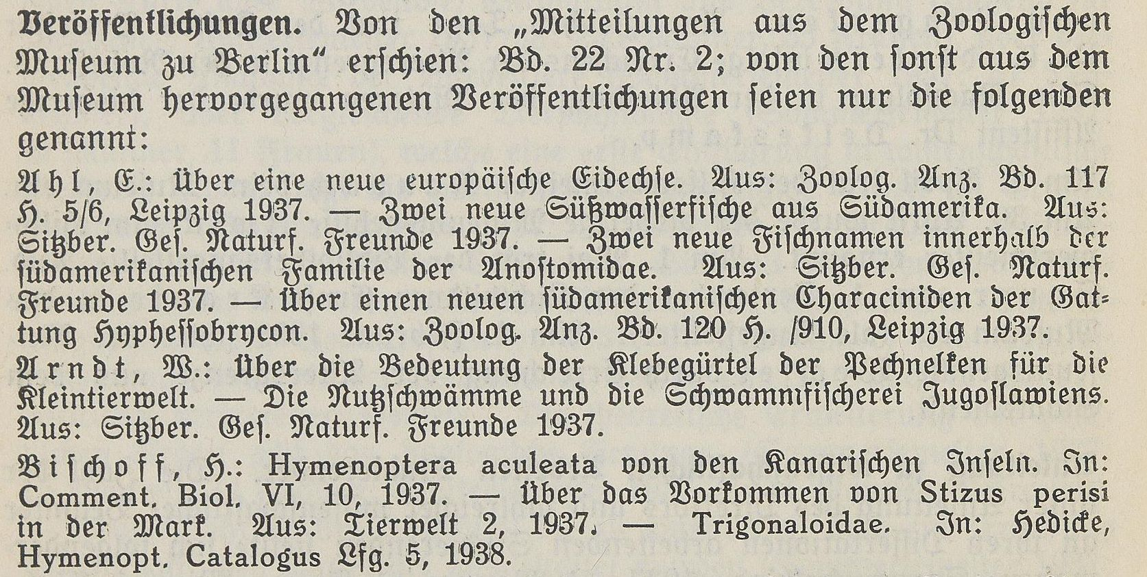
Publications
Chronik der Friedrich-Wilhelms-Universität zu Berlin, Vol. 18 (1904), S. 170
Topics addressed in the annual reports
Chronik der Friedrich-Wilhelms-Universität zu Berlin, 1937/1938, S. 162

Slide 13
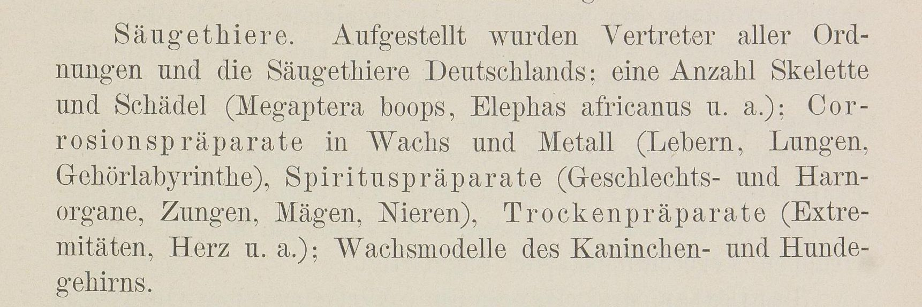
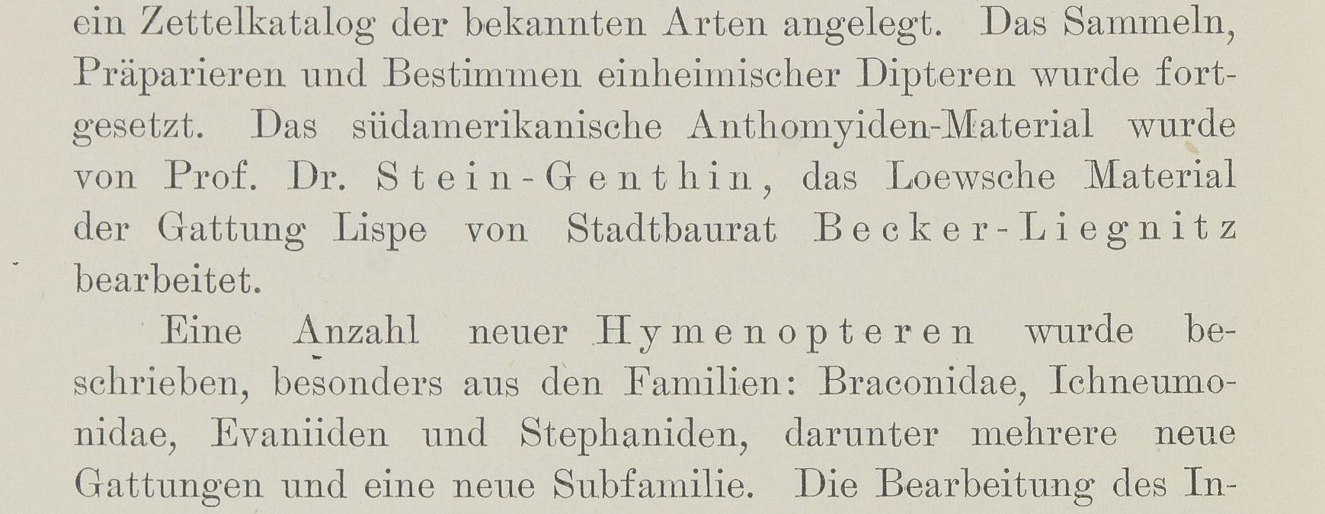
Development of the museum infrastructure, spatial arrangements, scientific evaluation and curation
Chronik der Friedrich-Wilhelms-Universität zu Berlin, Vol. 18 (1889), S. 141
Topics addressed in the annual reports
Chronik der Friedrich-Wilhelms-Universität zu Berlin, Vol. 18 (1904), S. 182

Slide 14
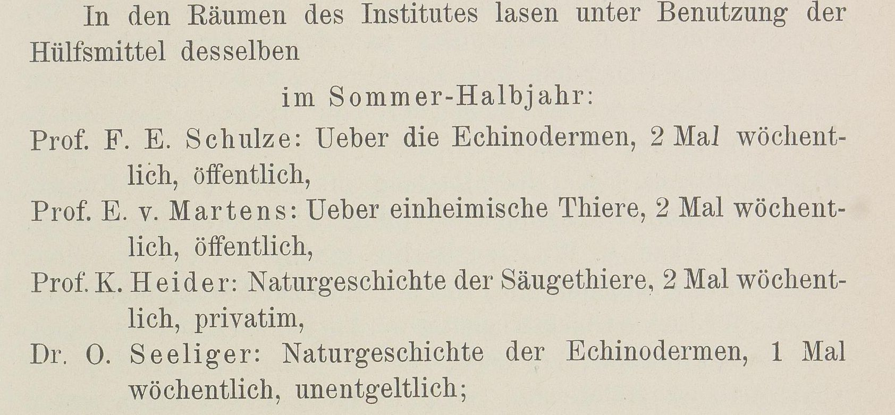
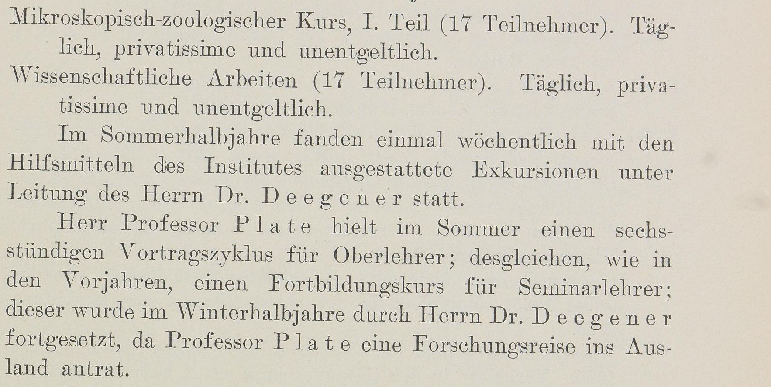
Lectures
Chronik der Friedrich-Wilhelms-Universität zu Berlin, Vol. 8 (1894), S. 113
Topics addressed in the annual reports
Chronik der Friedrich-Wilhelms-Universität zu Berlin, Vol. 18 (1904), S. 159

Slide 15
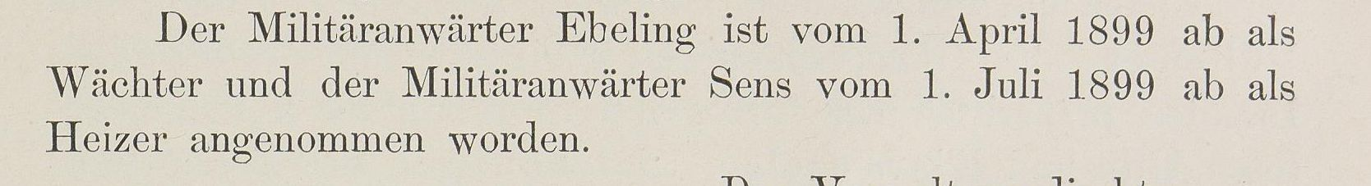
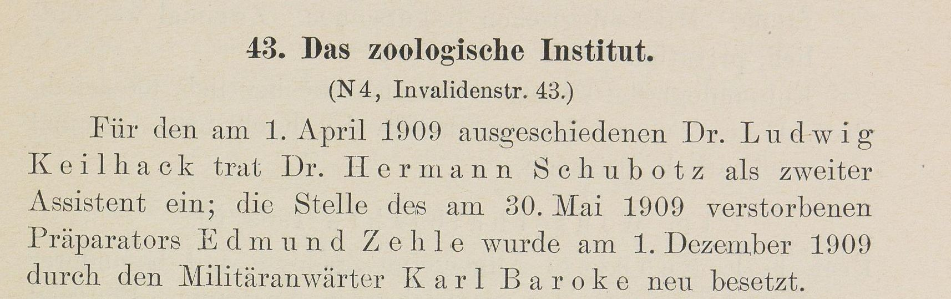
Organisational structure, Personnel changes
Chronik der Friedrich-Wilhelms-Universität zu Berlin, Vol. 13 (1899), S. 121
Topics addressed in the annual reports
Chronik der Friedrich-Wilhelms-Universität zu Berlin, Vol. 23 (1909), S. 181

Slide 16
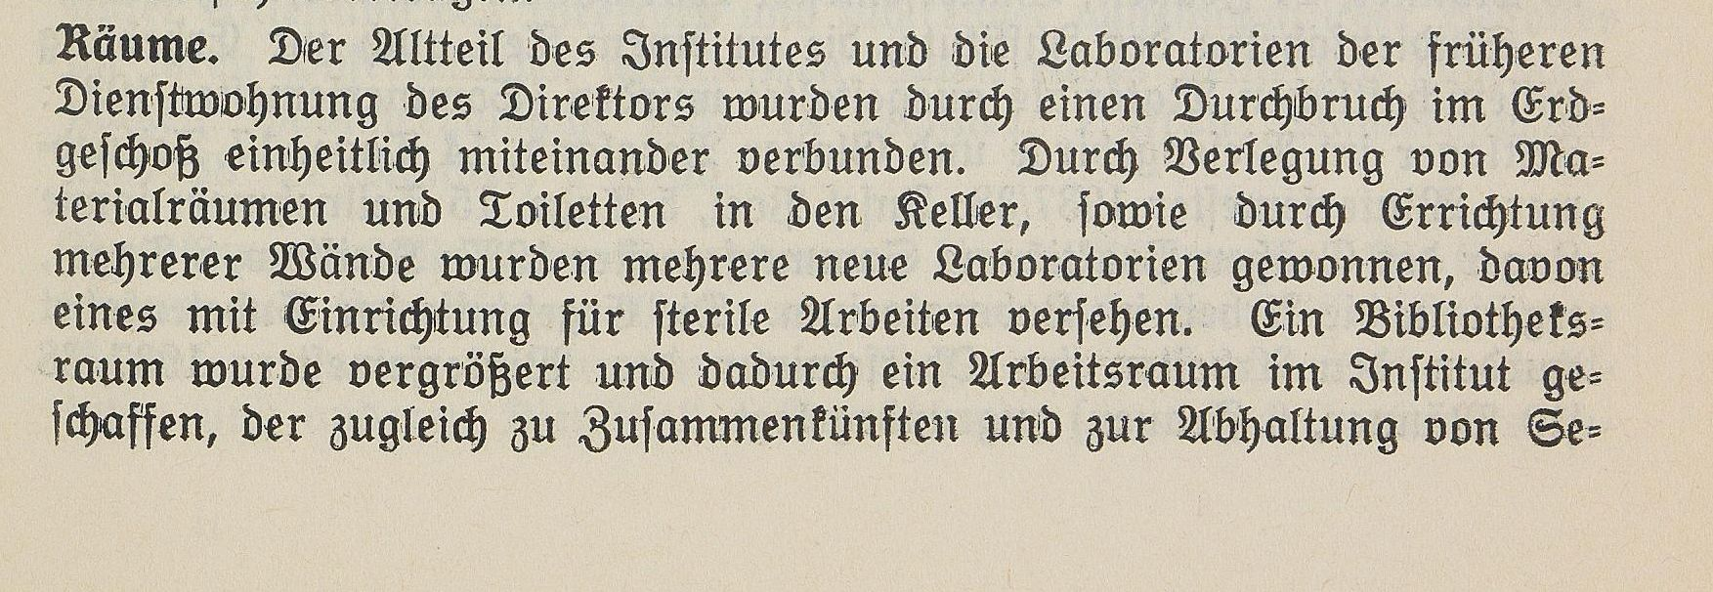
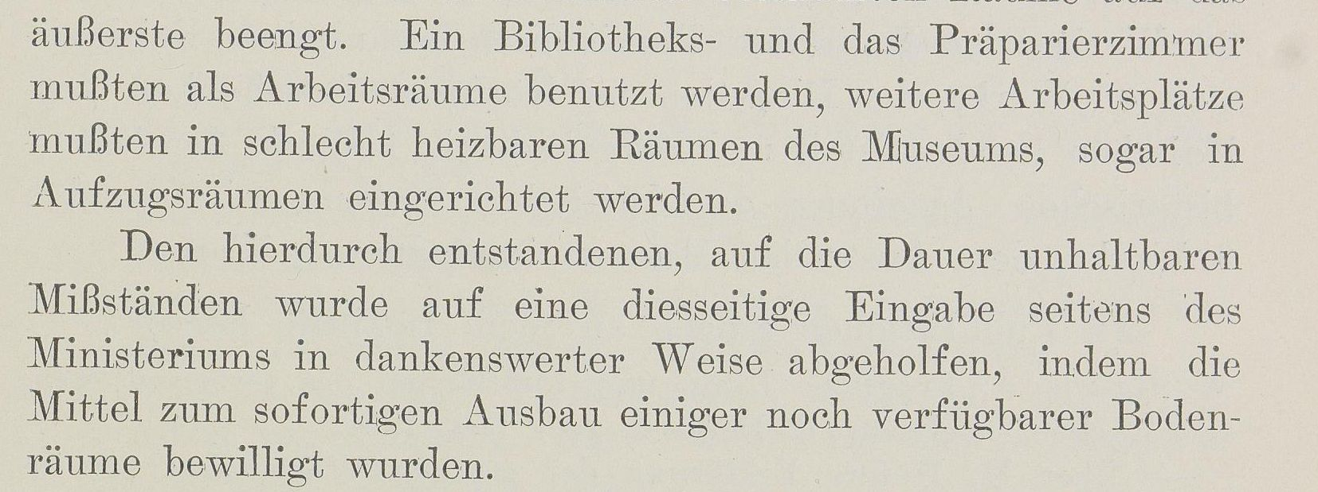
Use of space
Chronik der Friedrich-Wilhelms-Universität zu Berlin, 1937/1938, S. 159
Topics addressed in the annual reports
Chronik der Friedrich-Wilhelms-Universität zu Berlin, Vol. 18 (1904), S. 173

Slide 17
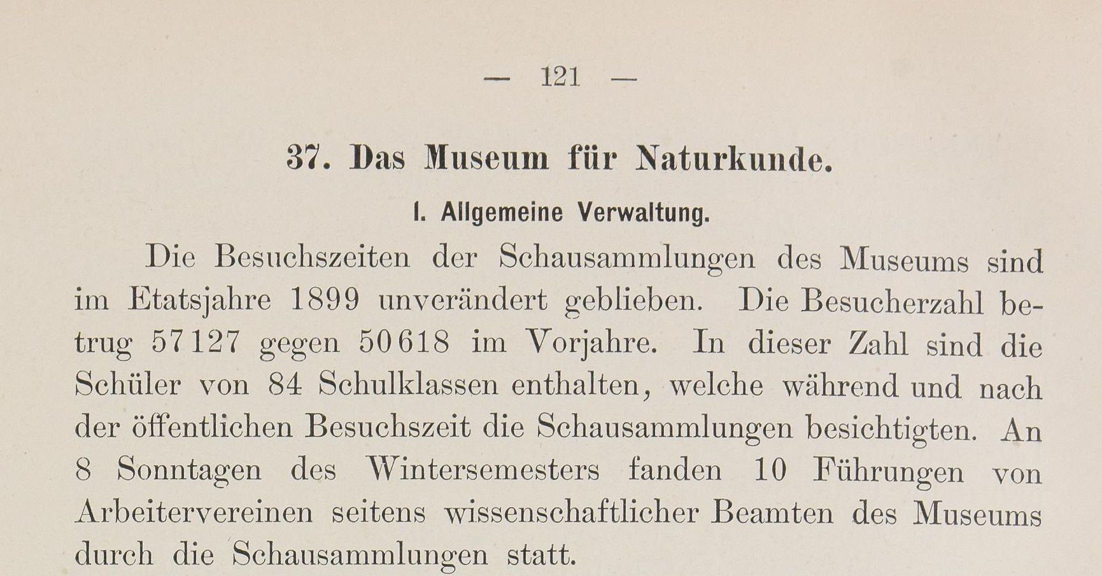
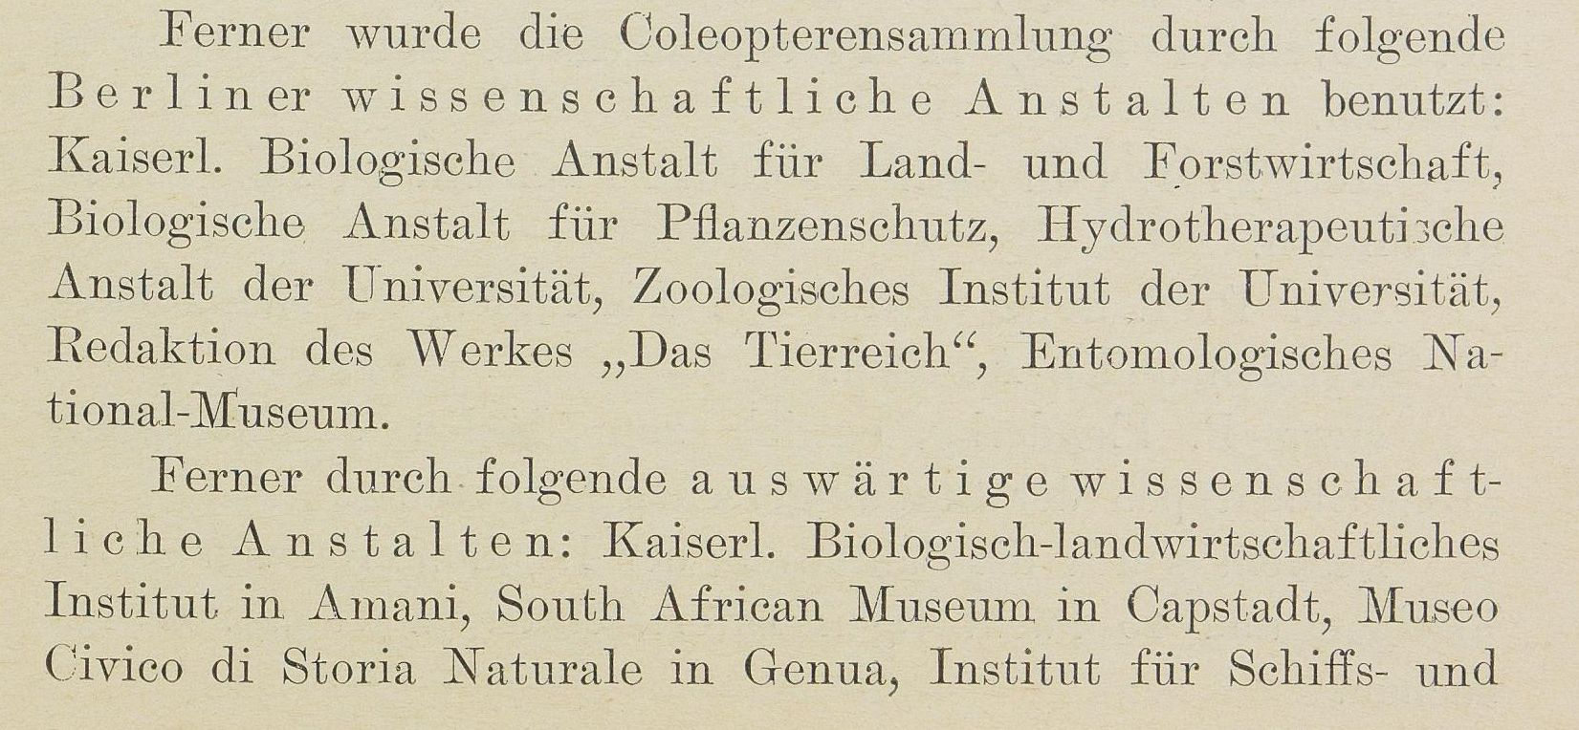
Public Sphere
audience
Chronik der Friedrich-Wilhelms-Universität zu Berlin, Vol. 13 (1899), S. 121
Topics addressed in the annual reports
scientific community
Chronik der Friedrich-Wilhelms-Universität zu Berlin, Vol. 23 (1909), S. 225

Slide 18

Words per topic
in %
Inflow and outflow of objects
17
28
33
36
49
10
11
7
35
Publications
2
23
22
24
18
10
1
37
20
Collection Management, curation activities
45
12
19
13
11
9
4
1
14
Public Sphere
12
22
9
11
9
10
2
12
11
Lectures
1
4
5
5
5
15
40
18
6
Organisational structure, Personnel changes
5
8
5
4
3
33
23
13
6
Library Acquisitions
3
2
6
6
2
7
16
4
4
1890
1900
1910
Use of space
10
1
1
1
2
5
0
5
2
Acquisitions of instruments
4
1
1
2
1
1
5
3
2
1889
1894
1899
1904
1909
1914
1928
1938
In total
1930
1940

Slide 19
Data model requirements
Extracting relevant information from heterogeneous texts → semantic annotations
Possibility to enrich the data easily with information from new internal or external data sources → Ontology for linked data in a knowledge graph
Sufficient modeling of the topics addressed → CIDOC-CRM

Slide 20
Knowledge graph

Slide 21
CIDOC CRM
Developed by the International Council for Documentation (CIDOC) of the International Council of Museums (ICOM) as ISO standard (ISO 21127)
Goal: providing definitions and a formal structure for describing the concepts and relationships used in cultural heritage documentation
Idea: each meaningful word in a text is assigned a class through annotating, labeled relationships between two of those assignments are possible
Can be interpreted by both humans and machines

Slide 22
CIDOC CRM in our project
Benefits to our project:
Easy integration of context information from external data sources (e.g. Wikidata)
Interoperability: just like the integration of external data, this data structure itself can be easily integrated into external data repositories
Sustainability: database becomes independent of software and documentation is available in the long term
Flexible and well thought-out architecture that allows for efficient modeling of unforeseen data during the annotation process

Slide 23
CIDOC CRM 7.1.1 Hierarchy I
E1 CRM Entity
E7 Activity: P15 was influenced by
P1 is identified by: E41 Appellation
E7 Activity: P17 was motivated by
P2 has type: E55 Type
E17 Type Assignment: P41 classified
P3 has note: E62 String
E24 Physical Human-Made Thing: P62 depicts
P48 has preferred identified: E42 Identifier
E89 Propositional Object: P67 refers to
P137 exemplifies: E55 Type
E31 Document: P70 documents
E32 Authority Document: P71 lists
E89 Propositional Object: P129 is about
E83 Type Creation: P136 was based on
E36 Visual Item: P138 represents
E13 Attribute Assignment: P140 assigned attribute to
E13 Attribute Assignment: P141 assigned
E77 Persistent Item
Semantic classes are hierarchical → reflect information with different levels of detail
Modeling:
Annotated word(s) are assigned a semantic class → semantic entity
The context of a semantic entity can be modeled by adding a labeled link to another semantic entity → these labeled links are called properties
The possible set of properties between two semantic classes are strictly defined and are inherited through the hierarchy
Latest stable version 7.1.1 was released in May 2021 and includes 81 Classes & 160 Properties
E5 Event: P12 occurred in the presence of
E63 Beginning of Existence: P92 brought into existence
E64 End of Existence: P93 took out of existence
E70 Thing
E7 Activity: P16 used specific object
P43 has dimension: E54 Dimension
E70 Thing: P130 shows features of
P101 had as general use: E55 Type
P130 shows features of: E70 Thing
E71 Human-Made Thing
E7 Activity: P19 was intended use of
P102 has title: E35 Title
P103 was intended for: E55 Type
E28 Conceptual Object
(1647)
Orang-Utang
E65 Creation: P94 has created

Slide 24
CIDOC CRM 7.1.1 Hierarchy II
E1 CRM Entity
E2 Temporal Entity
E92 Spacetime Volume
E52 Time-Span
E54 Dimension
E3 Condition State
E4 Period
E93 Presence
E97 Monetary Amount
E5 Event
E7 Activity
E63 Beginning of Existence
E64 End of Existence
E86 Leaving
E87 Curation Activity
E10 Transfer of Custody
E8 Acquisition
E11 Modification
E9 Move
E13 Attribute Assignment
E85 Joining
E65 Creation
E66 Formation
E67 Birth
E81 Transformation
E6 Destruction
E68 Dissolution
E69 Death
E96 Purchase
E79 Part Addition
E80 Part Removal
E17 Type Assignment
E12 Production
E14 Condition Assessment
E15 Identifier Assignment
E16 Measurement
E83 Type Creation
E1 CRM Entity
E53 Place
E77 Persistent Item
E70 Thing
E39 Actor
E72 Legal Object
E71 Human-Made Thing
E74 Group
E28 Conceptual Object
E18 Physical Thing
E90 Symbolic Object
E89 Propositional Object
E55 Type
E26 Physical Feature
E19 Physical Object
E24 Physical Human-Made Thing
E59 Primitive Value
E41 Appellation
E73 Information Object
E30 Right
E58 Measurement Unit
E56 Language
E57 Material
E99 Product Type
E27 Site
E20 Biological Object
E25 Human-Made Feature
E22 Human-Made Object
E78 Curated Holding
E62 String
E60 Number
E94 Space Primitive
E95 Spacetime Primitive
E61 Time Primitive
E42 Identifier
E36 Visual Item
E29 Design or Procedure
E33 Linguistic Object
E31 Document
E98 Currency
E21 Person
E35 Title
E37 Mark
E32 Authority Document
E34 Inscription

Slide 25
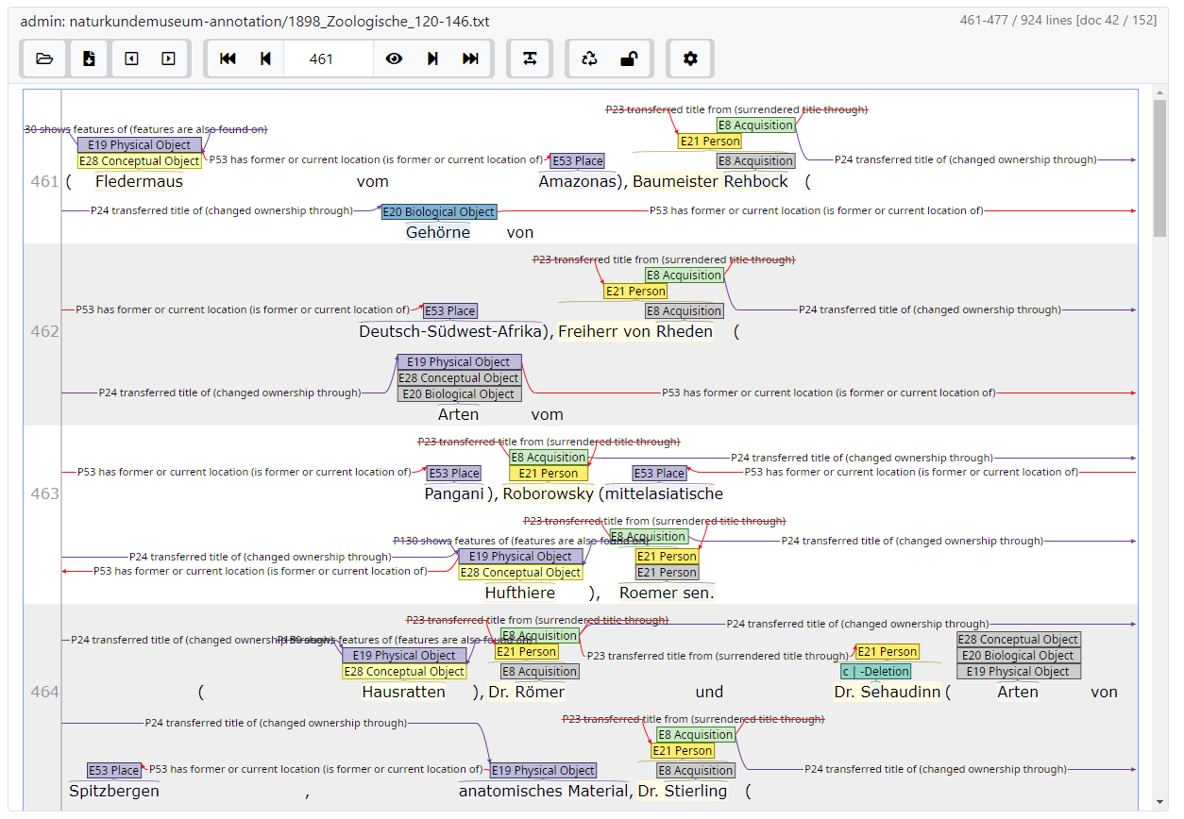
Virtual Entities
The very dense description in the reports has the consequence that:
Many terms are mentioned only implicitly through context but have no real explicit representation in the text
But we need those to correctly model the semantic structure using CIDOC CRM
Implementation of “virtual” entities which have no corresponding words in the text
This has the effect that there are paragraphs which consist of more entities than words
Manual annotating eats time!
(insert screenshot of INCEPTION densely annotated)

Slide 26
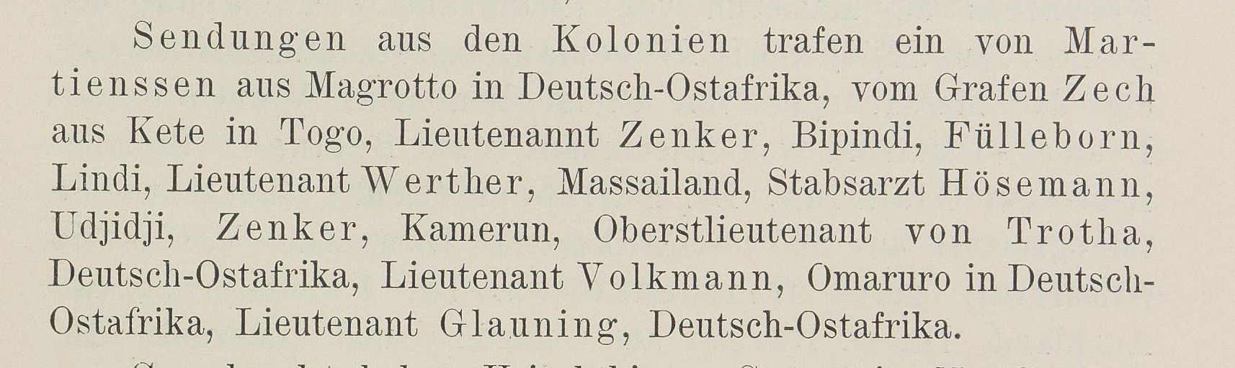
Virtual Entities
Neighbourhood for Entity No. 6824 in Zoologisches Institut und zoologische Sammlung (1897) with depth 2
E78 Curated Holding
...
(6772)
...
27 Neighbours
Reptilien und Amphibien
E21 Person
E41 Appellation
...
(6823)
P1
(14127)
...
10 Neighbours
E8 Acquisition
P23
P22
Lieutenant Werther
Werther
(6824)
(implicit) Unknown
P24
E19 Physical Object
E53 Place
...
(6825)
P53
(6615)
...
3 Neighbours
...
too many neighbours to draw
P2
(implicit) Unknown
Massai-Land
P1
is identified by
E55 Type
...
P2
has type
(7438)
...
75 Neighbours
P22
transferred title to
Donation
P23
transferred title from
P24
transferred title of
P53
has former or current location

Slide 27
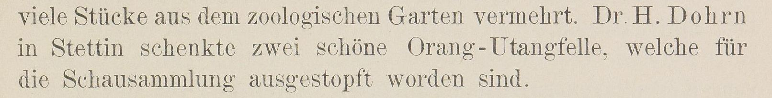
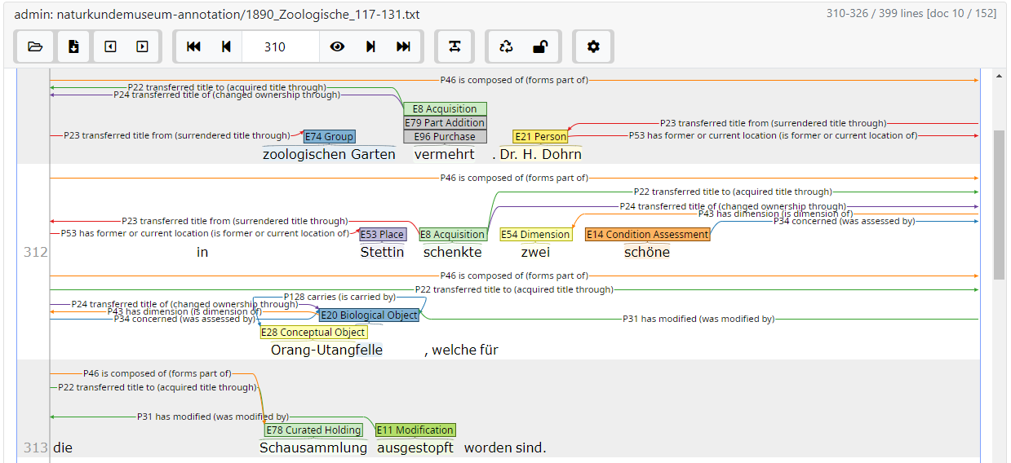
Modeling process
Neighbourhood for Entity No. 1647 in Zoologisches Institut und zoologische Sammlung (1890) with depth 4
E21 Person
E53 Place
(1642)
P53
(1643)
Dr. H. Dohrn
Stettin
E8 Acquisition
P23
(1644)
P2
E55 Type
...
schenkte
P24
(1929)
...
28 Neighbours
Donation
E14 Condition Assessment
E54 Dimension
(1646)
E20 Biological Object
(1645)
schöne
P34
(1648)
P43
P22
felle
P128
zwei
P31
E11 Modification
E28 Conceptual Object
(1650)
E78 Curated Holding
(1647)
ausgestopft
(1649)
P46
Schausammlung
OrangUtang
INCEpTION, https://inception-project.github.io
E78 Curated Holding
(1490)
...
Säugethiere
...
7 Neighbours
...
too many neighbours to draw
P2
has type
P22
transferred title to
P23
transferred title from
P24
transferred title of
P31
has modified
P34
concerned
P43
has dimension
P46
is composed of
P53
has former or current location
P128
carries

Slide 28
Status
Annotations:
11538 entities representing 39 semantic classes, connected by 12610 properties of 60 types
We greatly underestimated the effort required for manual annotating, so lately we have been focusing only on acquisitions of objects
Product:
Frontend: Prototype of Website
Backend: draft of model, in contact with Web Team
Semantic Class | Σ of entities
E21 Person | 2178
E53 Place | 1493
E8 Acquisition | 1020
E19 Physical Object | 1012
E20 Biological Object | 536
E78 Curated Holding | 503
E28 Conceptual Object | 452
E54 Dimension | 383
E55 Type | 214
E74 Group | 189
… | …
Semantic Property | Σ of entities
P23 transferred title from | 2424
P2 has type | 2363
P53 has location | 2095
P24 transferred title of | 1260
P23 transferred title to | 1158
P43 has dimension | 670
P130 shows features of | 639
P46 is composed of | 609
P4 has time-span | 365
P94 has created | 176
… | …

Slide 29
Product
Semantically annotated texts of the annual reports of the Museum
RDF/XML-Files
TEI/XML-Files
Website for interactive exploration through
Querying of Annotations
Visualization of annotations in their textual context
Visualization of annotations in their semantic context
Presentation of (exemplary) analyses
(Simple web system for delivering the data)

Slide 30
On demand rendering of semantic subgraphs
E55 Type
P2
(11537)
Donation
E74 Group
(11535)
Reichszentrale für naturwissenschaftliche Berichterstattung
E74 Group
E53 Place
(11533)
P53
(11534)
E8 Acquisition
P23
P23
Gesellschaft Naturforschender Freunde zu Berlin
Berlin
(11528)
Zuwachs
P24
E19 Physical Object
E54 Dimension
(11530)
P43
(11529)
Nummern
1064
E78 Curated Holding
E60 Number
E55 Type
P22
(11527)
P43
(11531)
P2
(11532)
Bibliothek
54 399
Schlussnummer
E21 Person
P23
(11536)
Professor Dr. Apstein
P2
has type
Neighbourhood for Entity No. 11536 in Zoologisches Institut und zoologische Sammlung (1928) with depth 4
P22
transferred title to
P23
transferred title from
P24
transferred title of
P43
has dimension
P53
has former or current location

Slide 31
On demand rendering of semantic subgraphs
Neighbourhood for Entity No. 278 in Museum für Naturkunde - Allgemeine Verwaltung (1889) with depth 3
E78 Curated Holding
E53 Place
(279)
P55
(281)
E81 Transformation
P92
Schau-
Erdgeschoss
P2
E55 Type
...
(278)
(269)
...
Trennung der Sammlungen
E78 Curated Holding
E53 Place
Building
5 Neighbours
P92
(280)
(283)
P2
Haupt-Sammlung
P55
I. und II. Stockwerk
...
too many neighbours to draw
P1
is identified by
E41 Appellation
...
P2
has type
P1
(13845)
...
Hauptsammlung
14 Neighbours
P55
has current location
P92
brought into existence

Slide 32
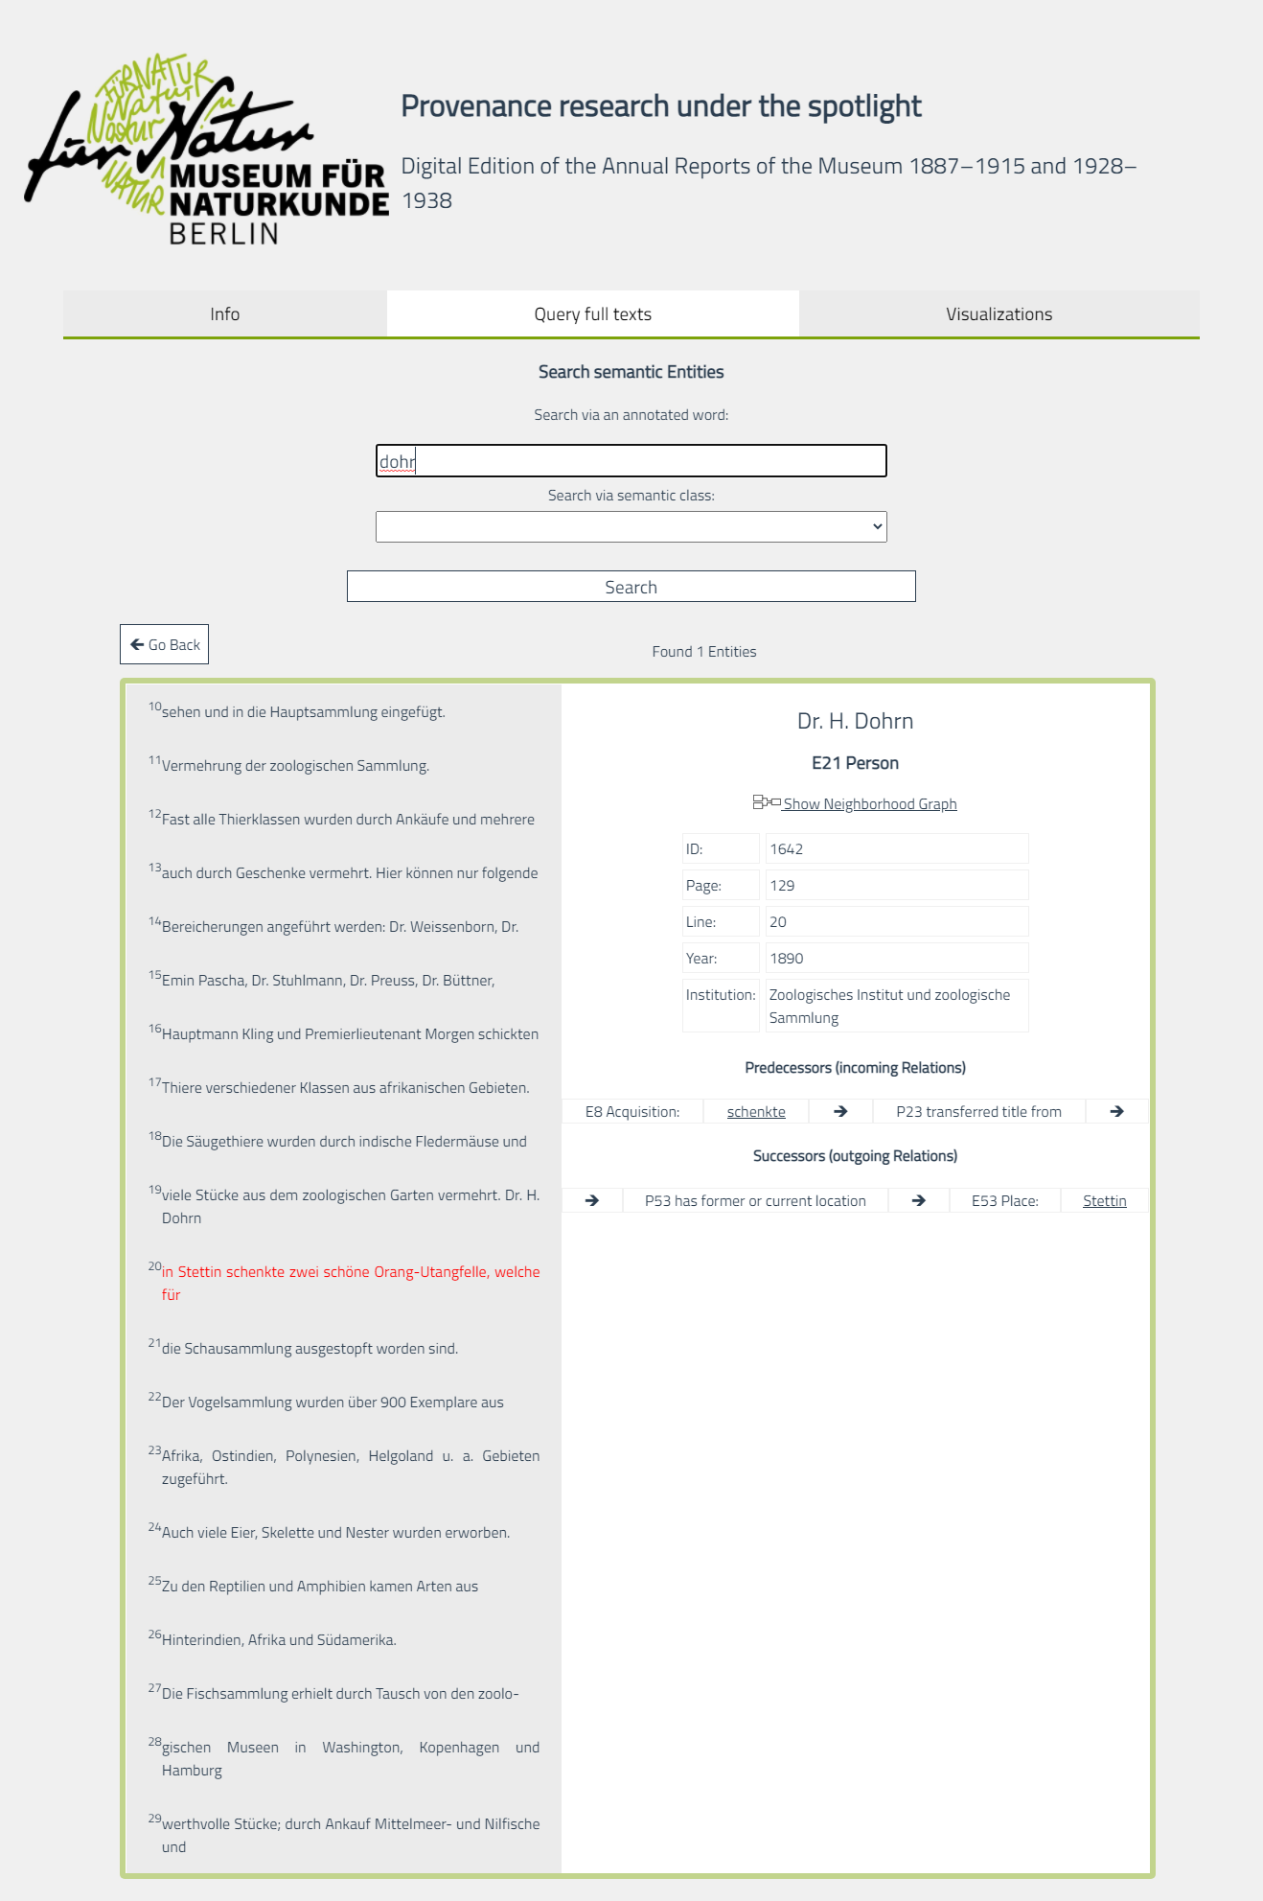
Prototype of Website

